Slide 1
Spring Data
Ayan Sengupta

Slide 2
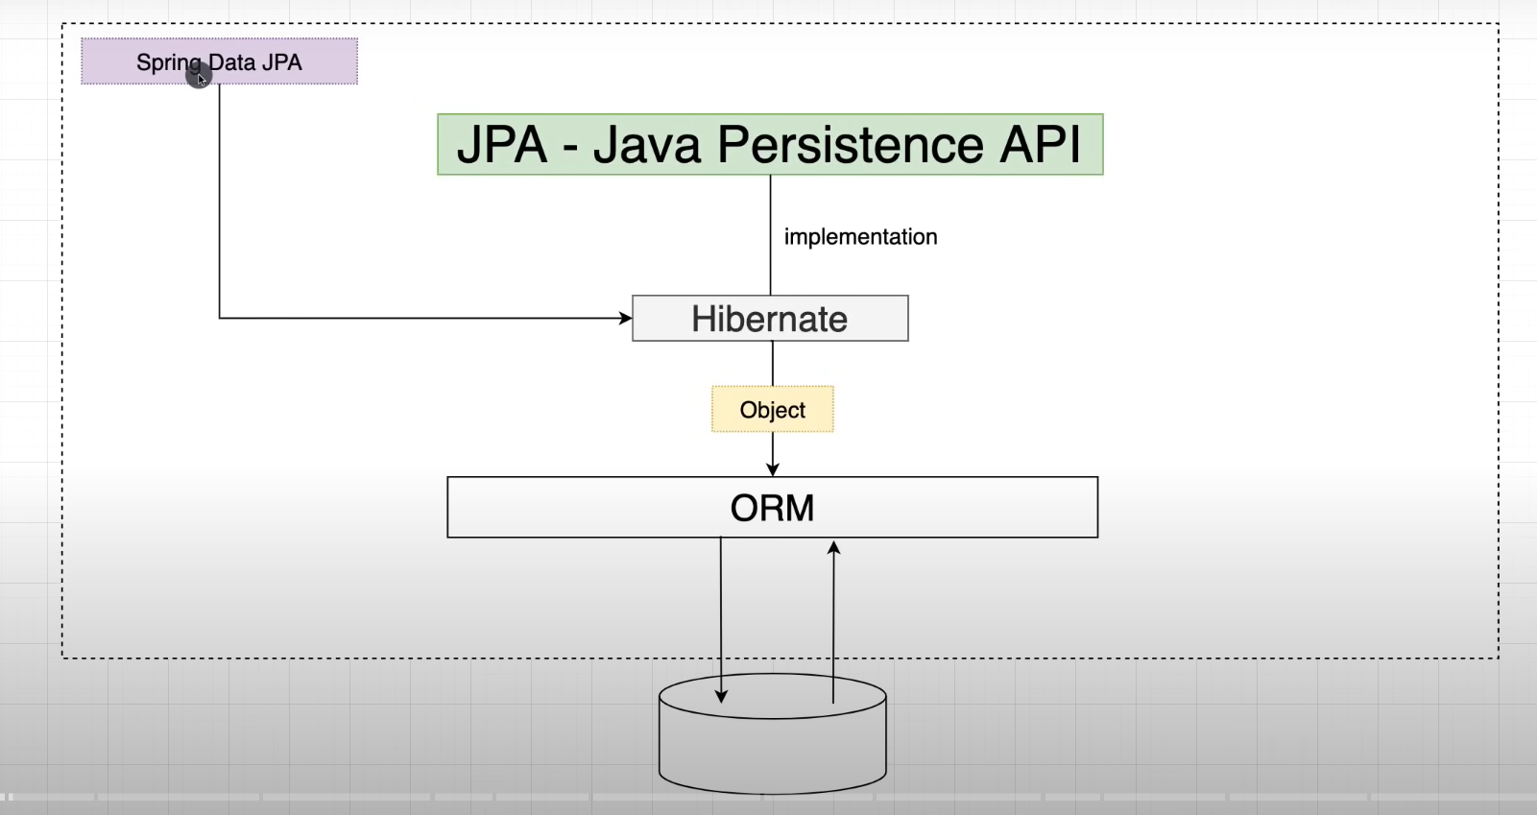
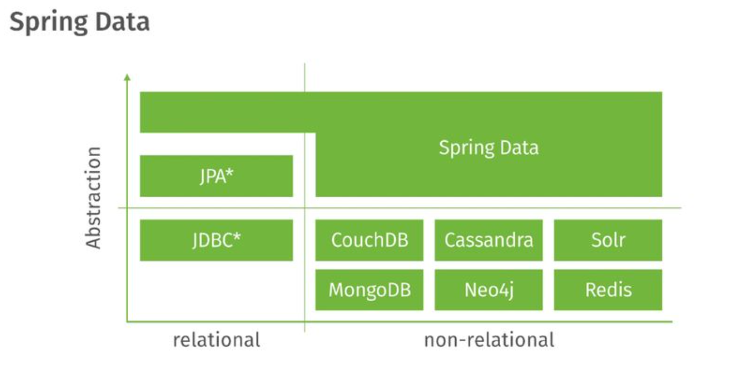
ORM is concept of converting the data from Object oriented language to relational DB and vice versa
JPA: Its the one step above ORM. Its high level API and specification so that different ORM tools can implement so that it provides the flexibility to developer to change the implementation from one ORM to another
Hibernate is the most popular implementation of Java Persistence API (JPA provided by Java). Others include Toplink and EclipseLink
Spring Data (VMWare) is an umbrella that provides
abstraction over JPA [Spring Data JPA]
abstraction over other relational technologies [Spring Data JDBC]
abstraction over non-relational technologies [Spring Data MongoDB, Spring Data Redis etc]

Slide 3
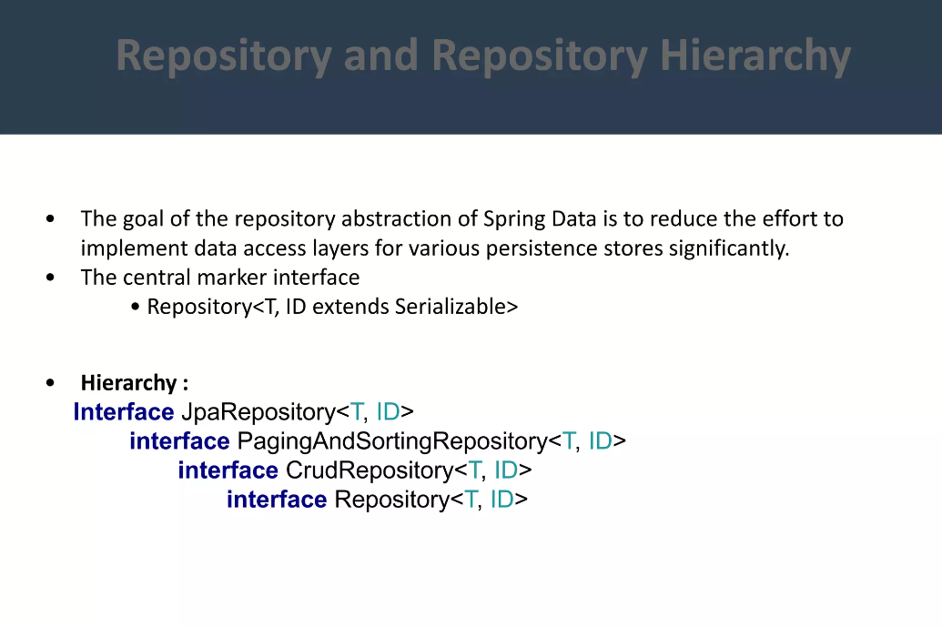
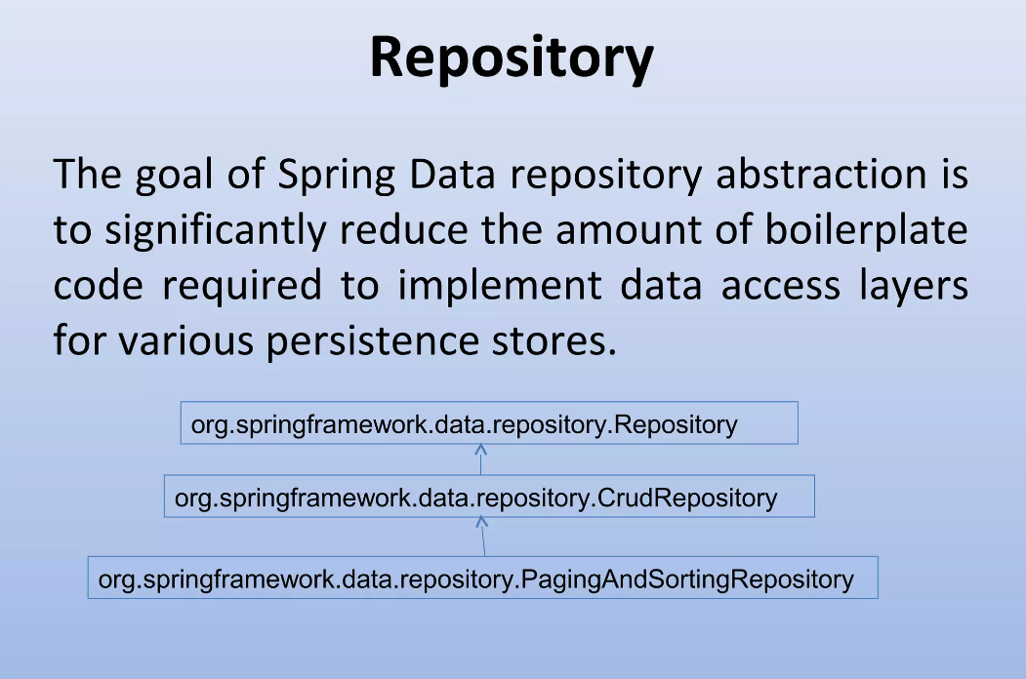
Repository Hierarchy

Slide 4
How to query using Repositories
Built in CRUD operations
Query Methods
JPA Named Queries
Using @Query

Slide 5
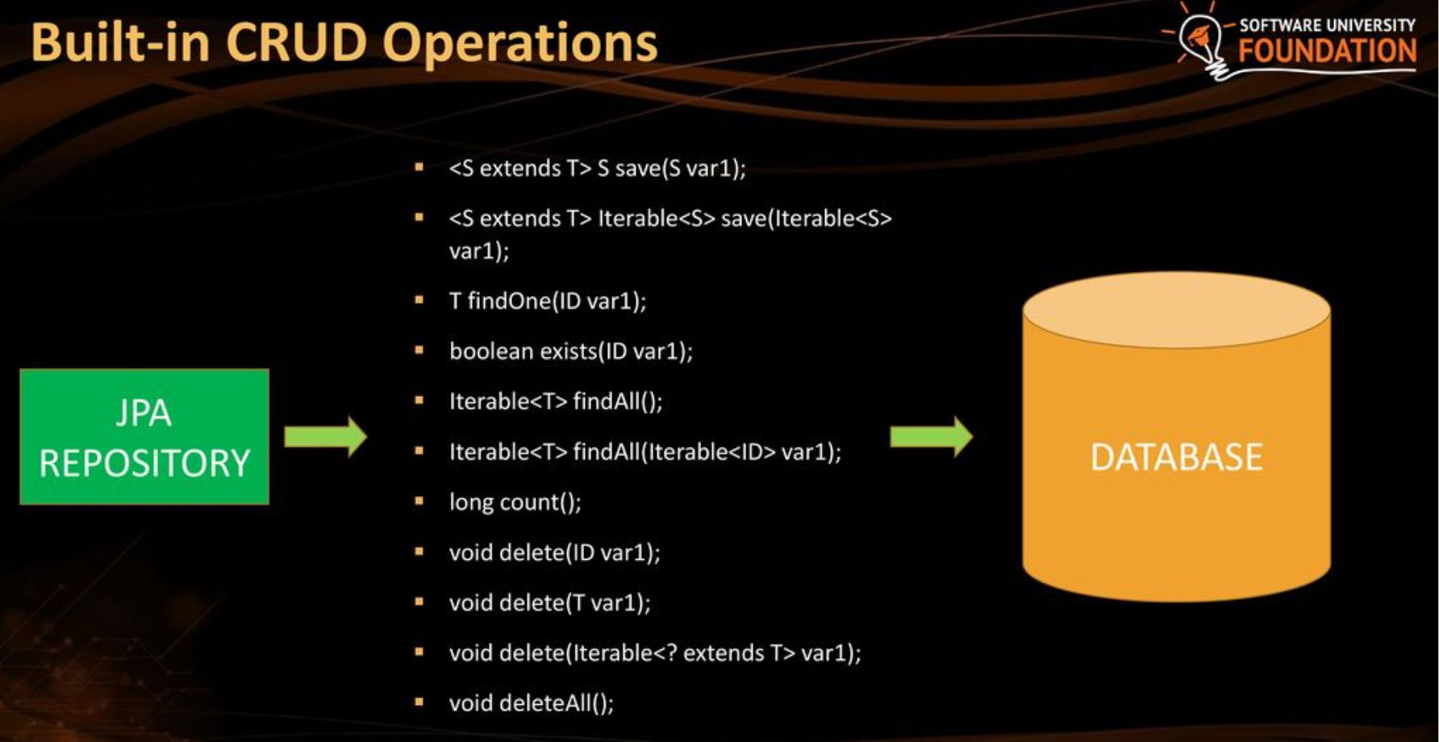
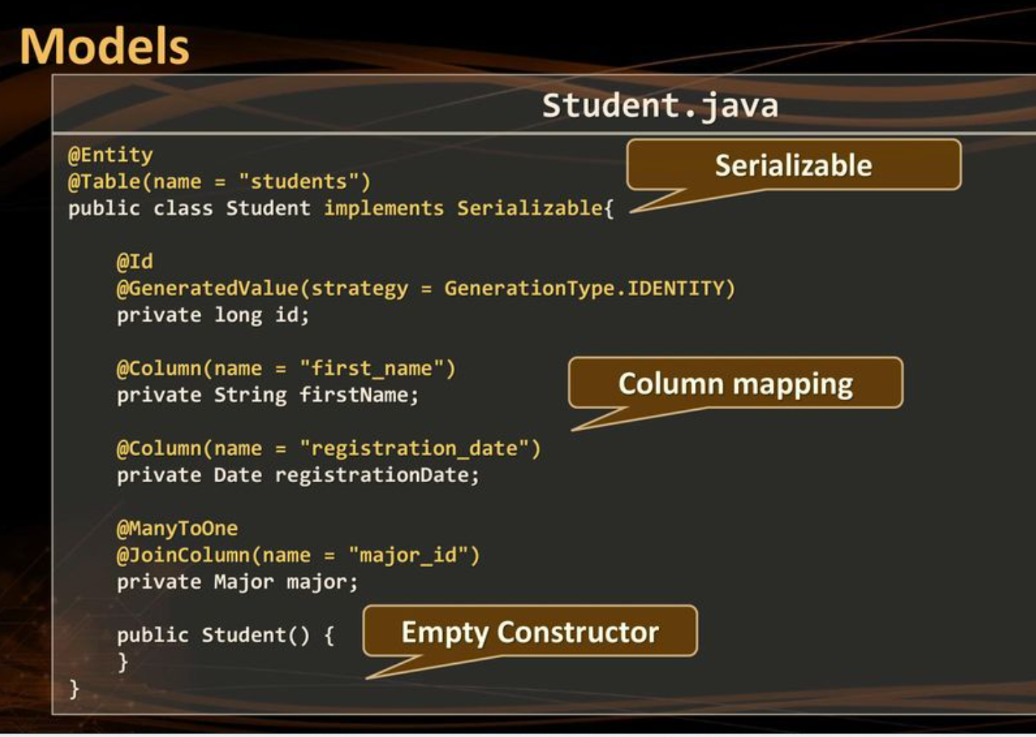
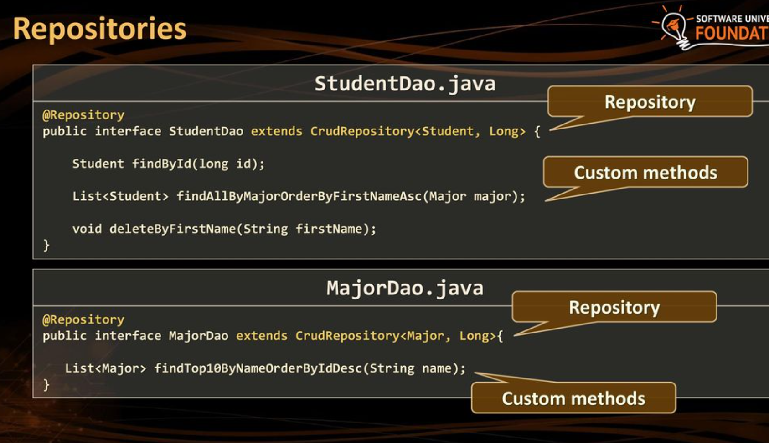
Built in CRUD operations provided out of the box
Need to map the Entity to Table
Use the entity class to create a repository. We can add query methods on top of the built in CRUD operations

Slide 6
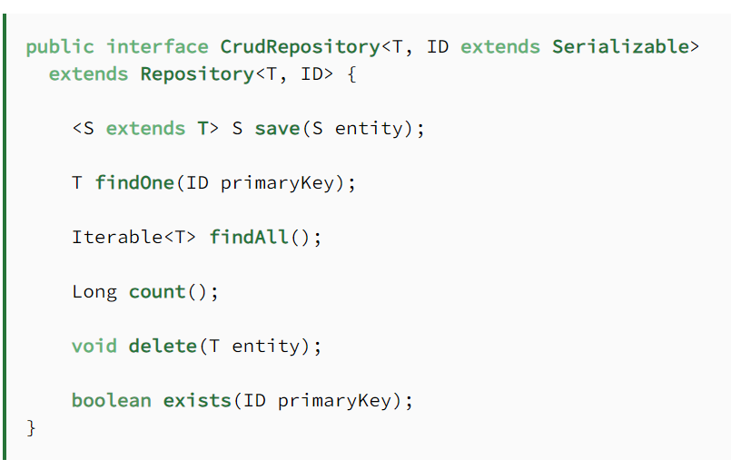
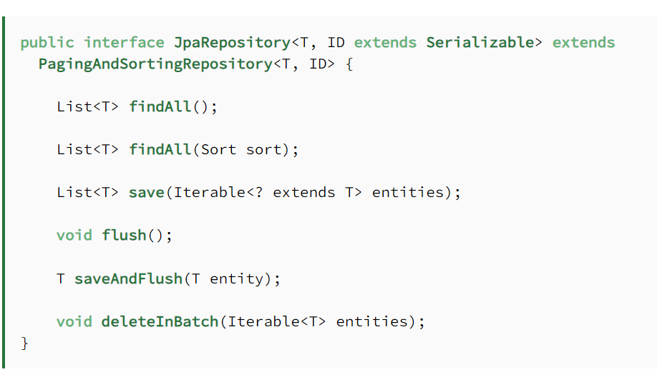
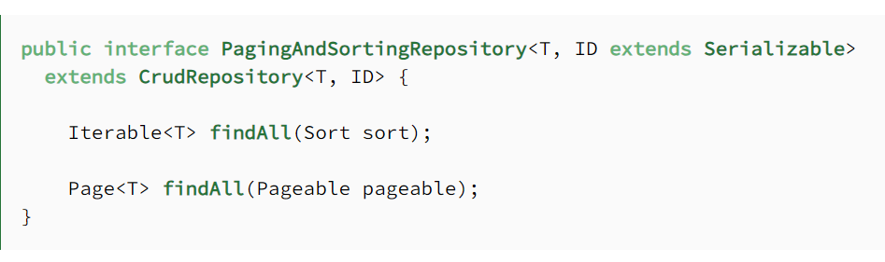
CrudRepository, JpaRepository, and PagingAndSortingRepository

Slide 7
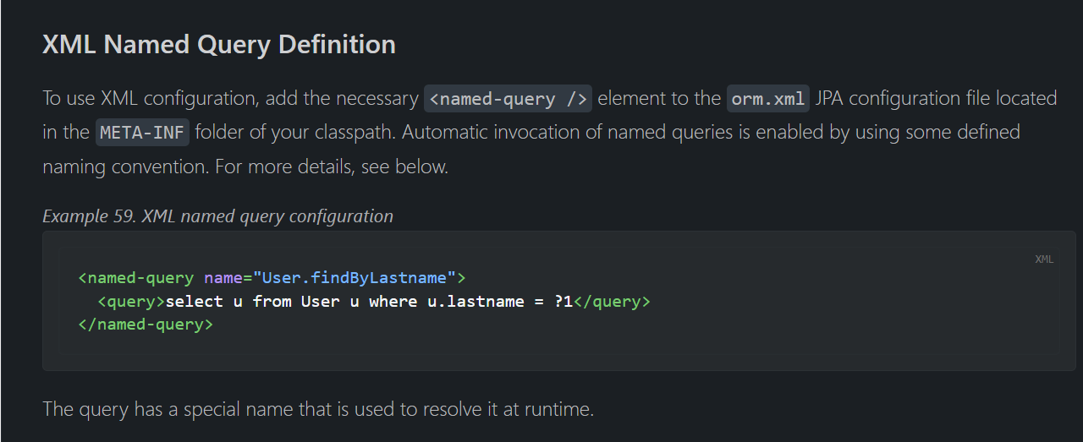
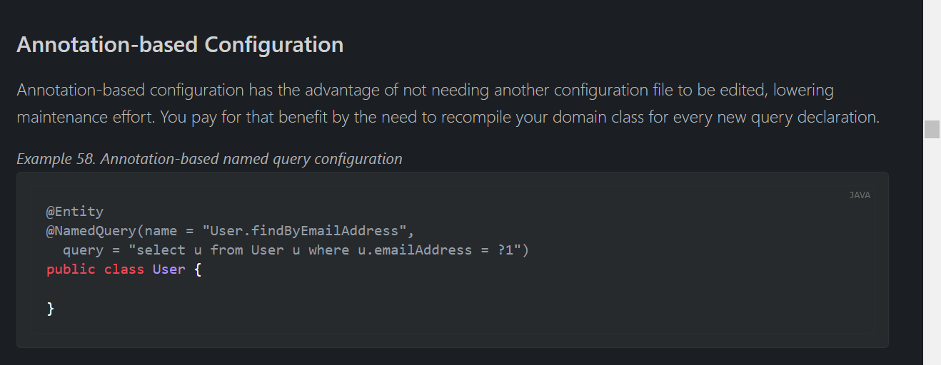
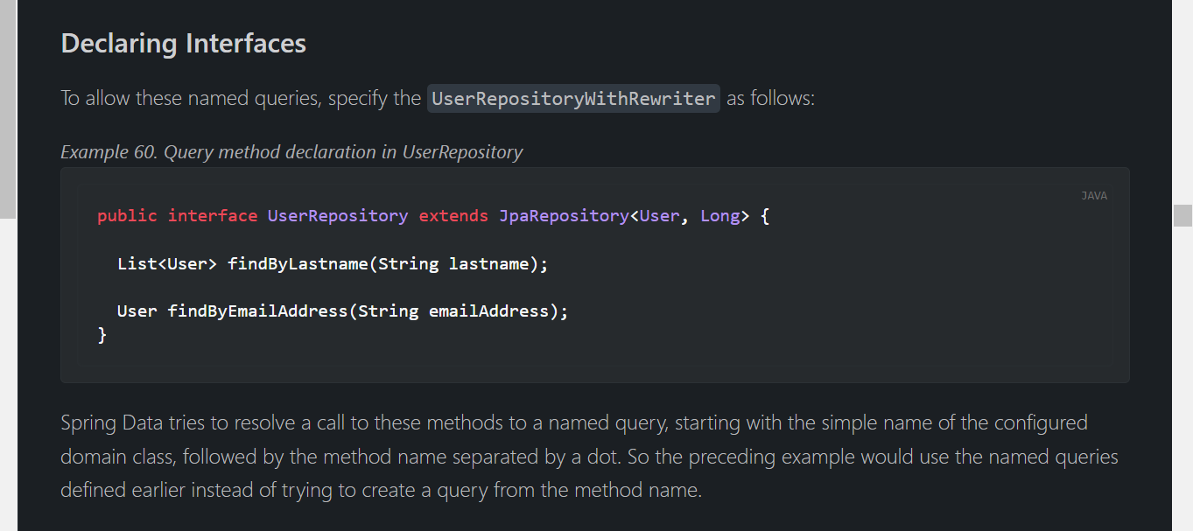
JPA Named Queries
XML based
Annotation based
Using these queries

Slide 8
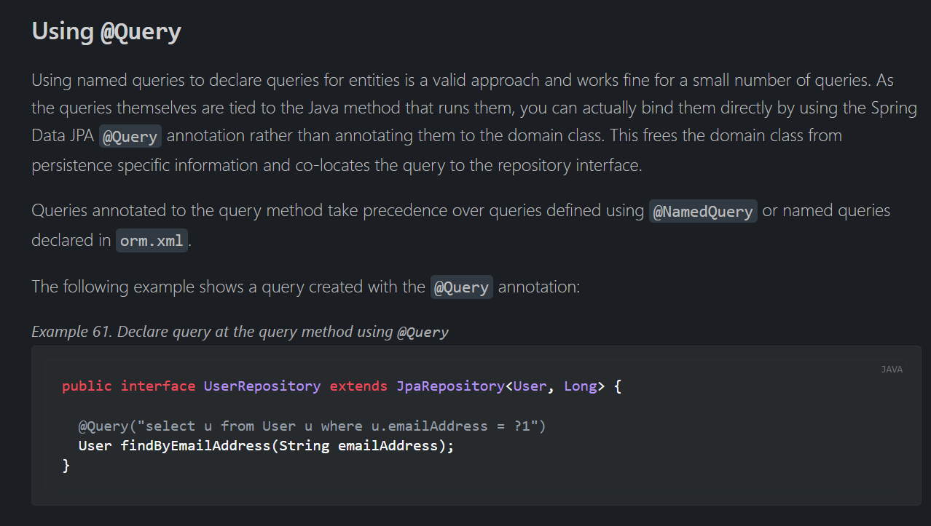
@Query

Slide 9
Entity Relationship
Entity Relationships are concepts derived from JPA in Spring Data
@OneToOne
@OneToMany
@ManyToOne
@ManyToMany
https://medium.com/@andhikayusup/spring-boot-guide-for-beginner-entity-relationship-65fd614f07c6

Slide 10
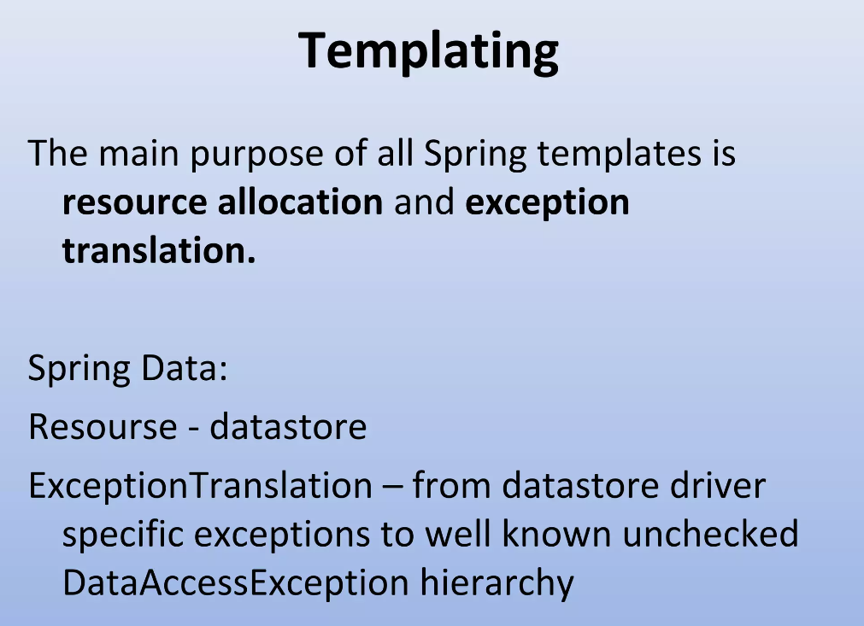
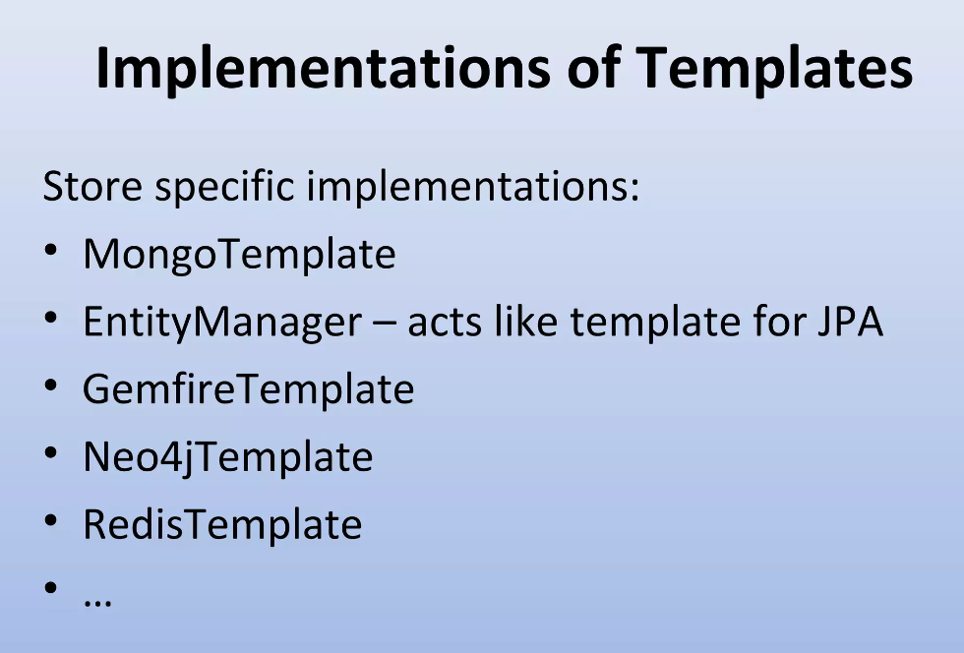
Repository vs Template
For example :
MongoTemplate provides "atomic" out-of-the-box operations updateFirst, updateMulti, findAndModify, upsert... which allow you to modify a document in a single operation. The Update object used by these methods also allows you to target only the relevant fields.
MongoRepository only gives you the basic CRUD operations find, insert, save, delete, which work with POJOs containing all the fields. This forces you to either update the documents in several steps (1. find the document to update, 2. modify the relevant fields from the returned POJO, and then 3. save it), or define your own update queries by hand using @Query.

Slide 11
References
https://spring.io/projects/spring-data
https://stackoverflow.com/questions/27462185/jpa-vs-orm-vs-hibernate
https://stackoverflow.com/questions/17008947/whats-the-difference-between-spring-datas-mongotemplate-and-mongorepository#:~:text=Repositories%20are%20by%20far%20more,control%20over%20what%20to%20execute.
https://www.baeldung.com/spring-data-repositories

